Slide 1
Customer Segmentation
Name: Greeshma C P
Project ID: CDACL-002
Tool Used: Orange Data Mining

Slide 2
PROJECT OVERVIEW
Objective of the analysis
Description of the dataset
Analytical approach and tools used
Key insights from customer segmentation
Business recommendations

Slide 3
PROBLEM STATEMENT
Understand customer shopping behavior using transaction data
Identify product categories where discounts should be applied
Analyze card spending patterns across different age groups
Study the influence of seasonal and regional factors on purchases

Slide 4
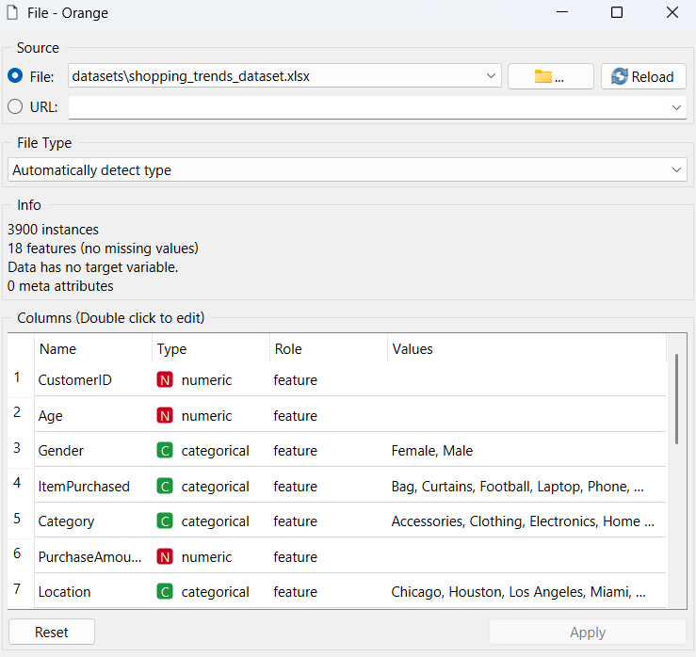
DATASET OVERVIEW
Dataset consists of 3900 customer purchase records.
Data represents shopping behavior across multiple US cities.
Includes demographic, transactional, and behavioral attributes.

Slide 5
METHODOLOGY
Tools Used
phpMyAdmin
Orange Data Mining
Methodology
Data understanding and preprocessing
Feature selection for analysis
K-Means clustering for customer segmentation
Visual analysis using scatter plots and distributions

Slide 6
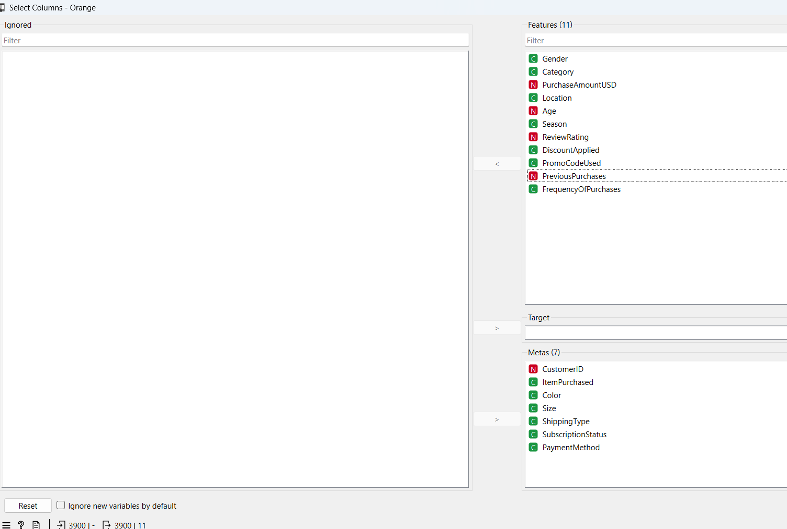
Feature Selection
Feature Selection
Relevant numerical and categorical features were selected.
Identifier attributes were excluded from clustering.

Slide 7
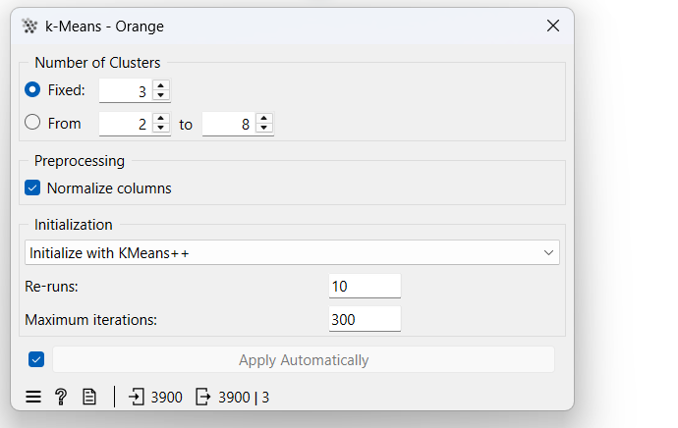
CLUSTERING SETUP
Clustering Approach
Unsupervised learning using K-Means clustering.
Customers grouped based on behavioral similarity.

Slide 8
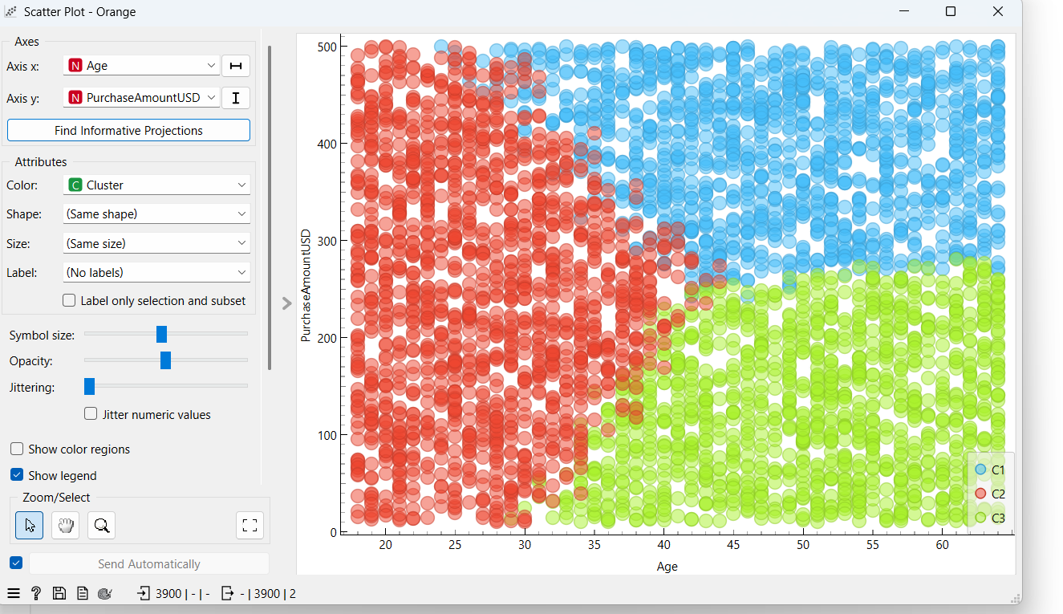
Customer Clusters Visualization
Customers are segmented into three distinct clusters.
Each cluster represents customers with similar age and spending behavior.
Clear separation indicates effective clustering.

Slide 9
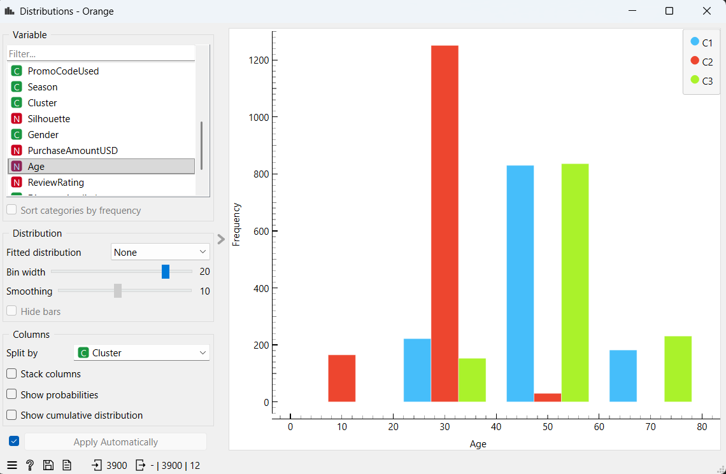
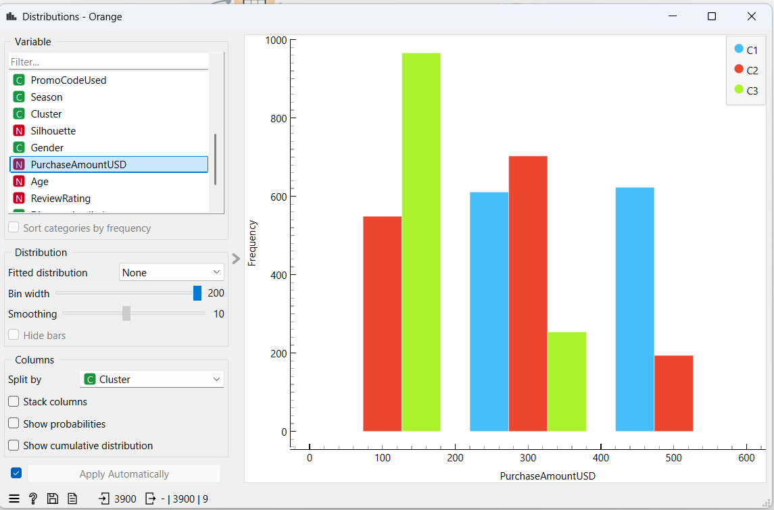
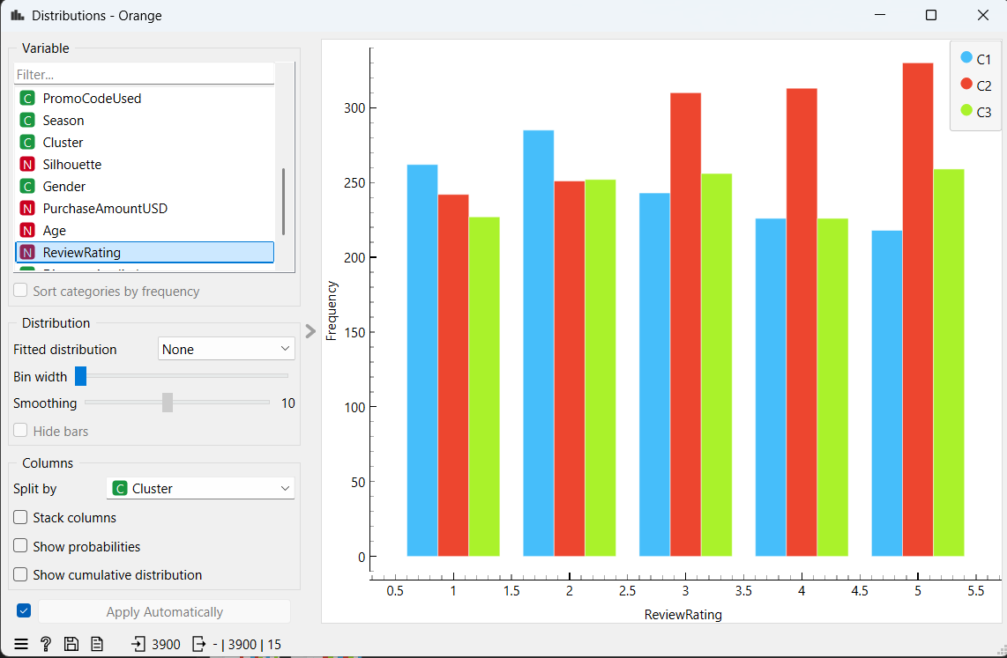
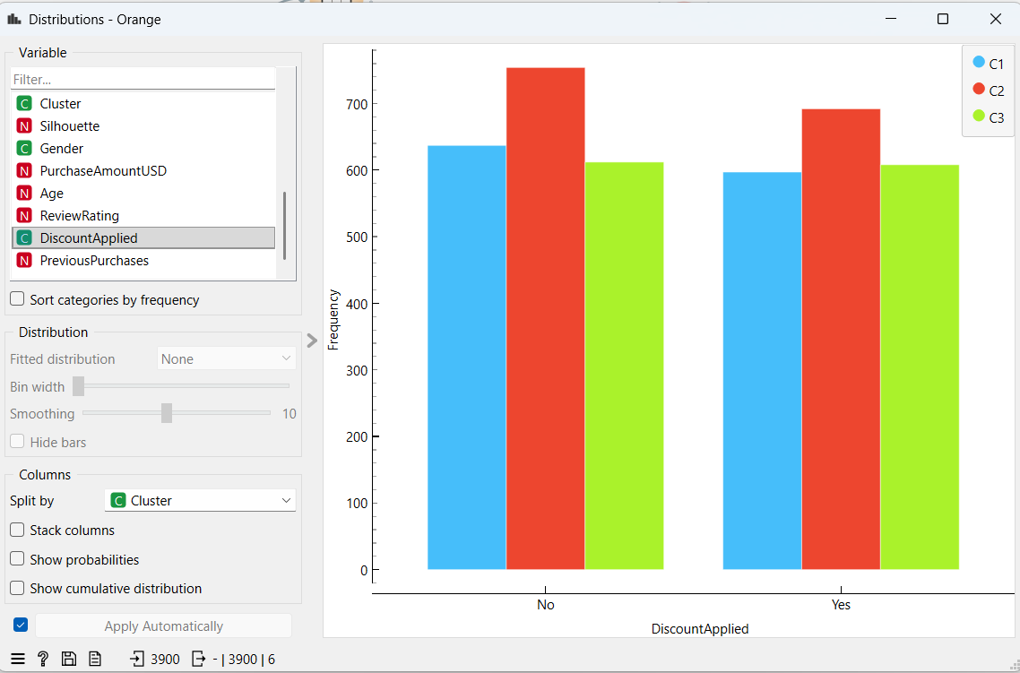
CLUSTER-WISE DISTRIBUTION & BEHAVIOR ANALYSIS
Observations
Each cluster shows a distinct age profile.
Spending patterns vary significantly across clusters.
Indicates effective and meaningful customer segmentation.

Slide 10
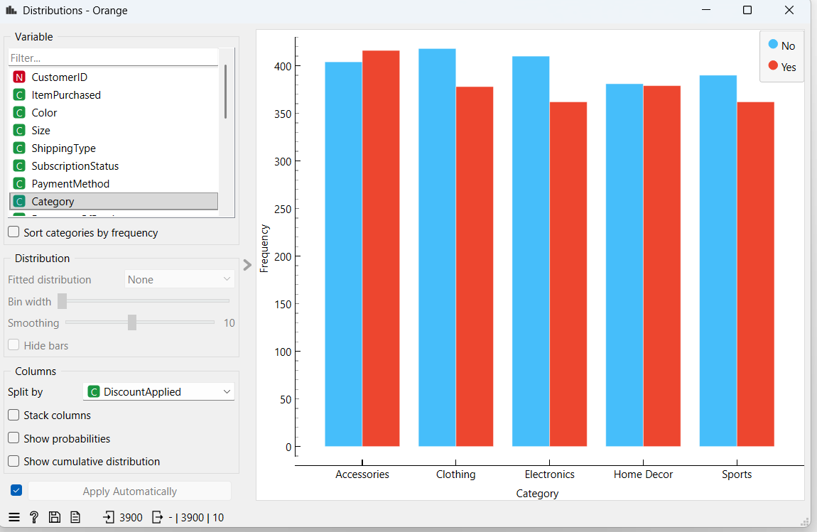
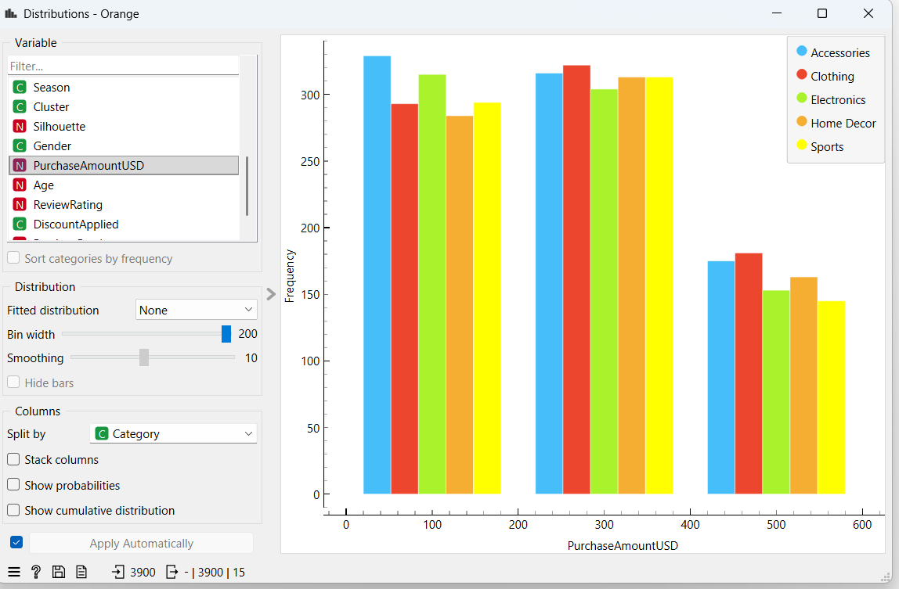
CATEGORY & SEASONAL INSIGHTS
Key Observations
Purchase behavior varies across product categories.
Seasonal trends influence customer buying patterns.
Certain categories show higher engagement during specific seasons.

Slide 11
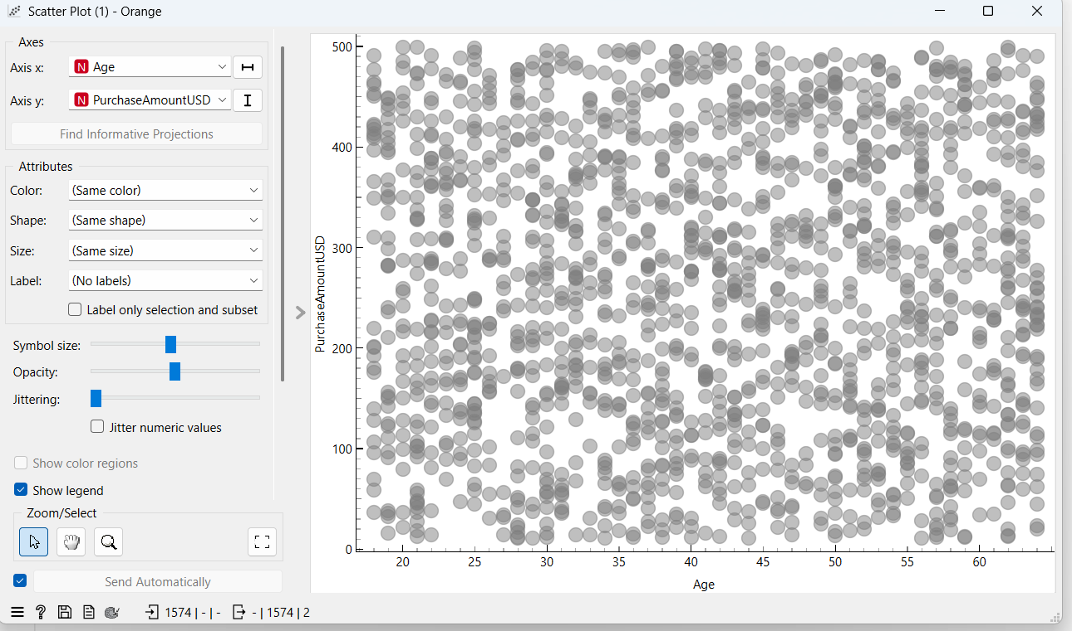
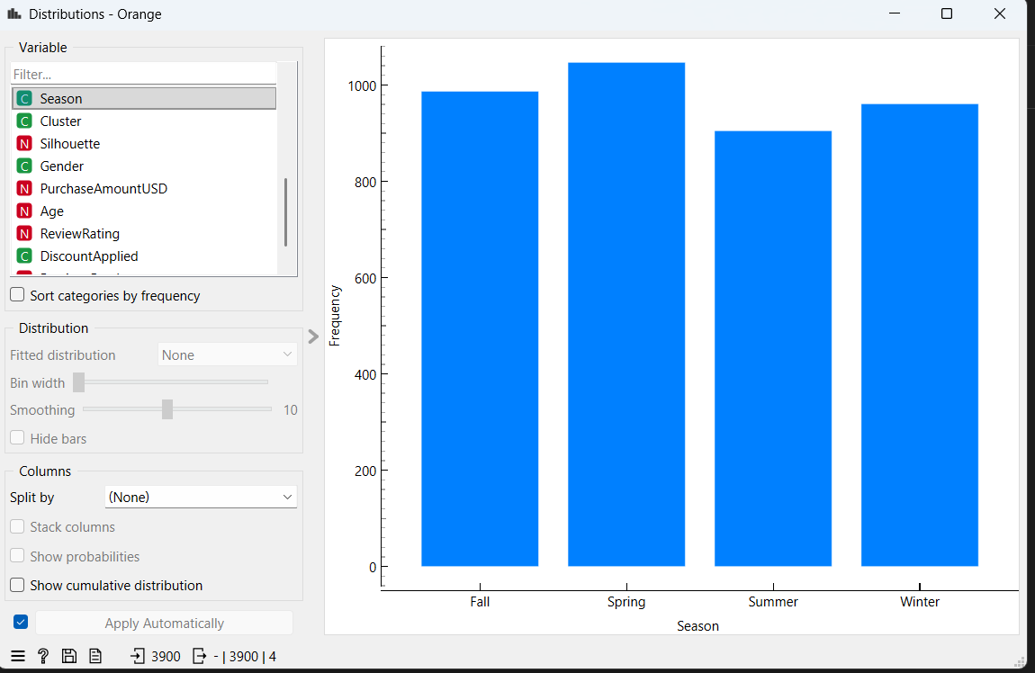
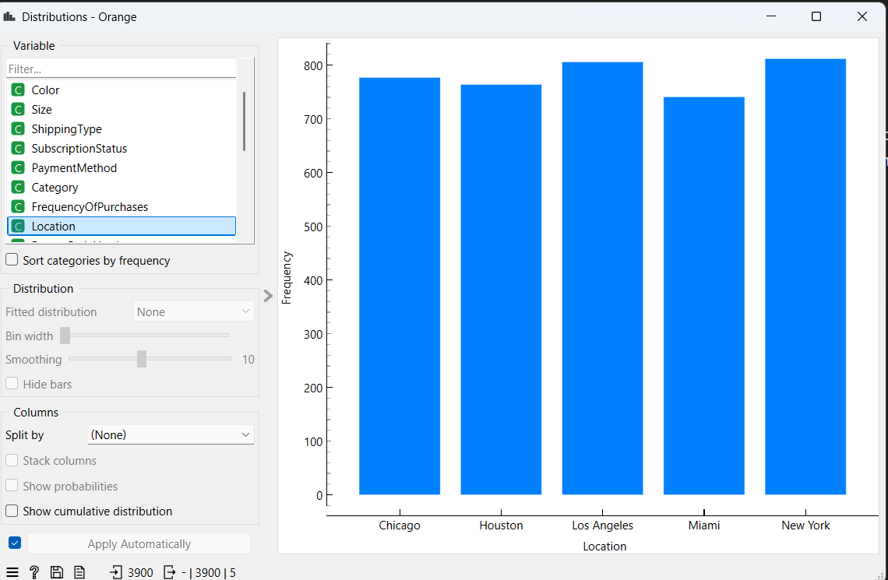
Customer Payment and Purchase Behavior
Multiple payment options improve customer convenience.
Digital-first customers can be targeted with online offers.
High-frequency buyers are strong candidates for loyalty programs.

Slide 12
CONCLUSION & RECOMMENDATIONS
Conclusion
Customer segmentation successfully identified three distinct customer groups.
Each cluster exhibits unique demographic and behavioral characteristics.
The segmentation provides actionable business insights.
Recommendations
Target high-value customers with personalized offers.
Use discounts strategically for price-sensitive clusters.
Design cluster-specific marketing and retention strategies.

